Slide 1

Back to the Basics: T-SQL 101
Deborah Melkin
April 29, 2020

Slide 2



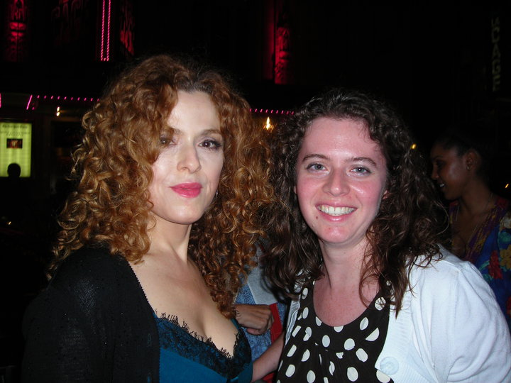
The Basics About Me
Worked as a DBA for 20 years:
Mainly work with SQL Server but have worked with Oracle, MySQL, Informix and PostgreSQL
NESQL board member
User Group & SQL Sat speaker
IDERA ACE Class of 2020
Speaker Idol 2019 Winner
Random facts:
I’m the alto section leader in my choir.
I go to bluegrass jams regularly.
I’ve been learning guitar and now mandolin.
I am a bit of a musical theater geek.

Slide 3
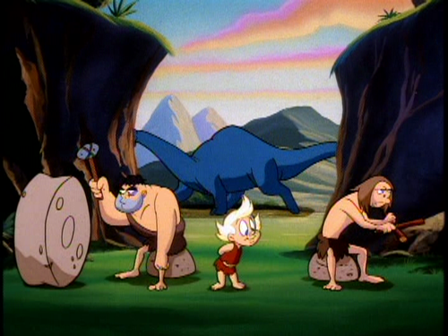

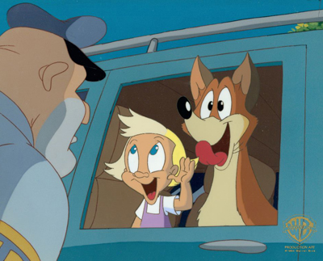
Goals 101
Understand what the different parts are which make up queries.
Begin to think about how these different parts work together to answer not only what are they doing but why that query.
Learn 1 new thing.
Notes:
“whatcha doing Mr. Man? Why? Why? Why?”
->
Whatcha doing Mr. Query? Why? Why? Why?

Slide 4
Types of SQL Statements
Data Definition Language (DDL)
Statements that create, modify, or delete database objects
Data Manipulation Language (DML)
Statements that modify data
May also be referred to as CRUD operations
This is our focus!

Slide 5
Breaking down the CRUD
CREATE (INSERT)
UPDATE (UPDATE)
READ (SELECT)
DELETE (DELETE)
CREATE = INSERT
READ = SELECT
UPDATE = UPDATE
DELETE = DELETE
The CRUD operations in action.

Slide 6
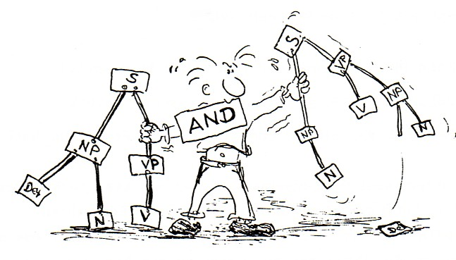
SQL Syntax

Slide 7

The Basic Statement: SELECT
The SELECT statement is the basis for the other DML statements.
You will write more SELECT statements than any other type of SQL statement.

Slide 8
SELECT Statement
SELECT <column list>
FROM <table(s)>
WHERE <where condition>
Limits the columns that are being returned
States the table\tables being working with
Limits the rows that are being returned
Notes:
Reminder: You only want to work with the data you need. This is true not only for rows but columns as well.

Slide 9
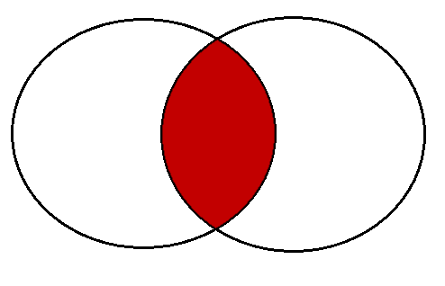
Tables and JOINs
A JOIN defines the related column or columns between two tables.
Types of Joins
INNER
OUTER
LEFT
RIGHT
FULL
CROSS JOIN

Slide 10

Visualizations of JOINS
Image from: https://www.codeproject.com/kb/database/visual_sql_joins.aspx

Slide 11
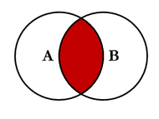
INNER JOIN
Rows are returned when there are records in both tables based on the JOIN criteria.
SELECT <select_list>
FROM TableA A
INNER JOIN TableB B
ON A.Key = B.Key

Slide 12
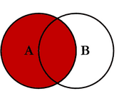
LEFT OUTER JOIN
Records are returned from the “Left” table and matching records from the “Right” table
SELECT <select_list>
FROM TableA A
LEFT OUTER JOIN TableB B
ON A.Key = B.Key

Slide 13
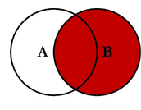
RIGHT OUTER JOIN
Records are returned from the “Right” table and matching records from the “Left” table
SELECT <select_list>
FROM TableA A
RIGHT OUTER JOIN TableB B
ON A.Key = B.Key

Slide 14
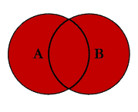
FULL OUTER JOIN
Returns records from the “Left” table and “Right” table, regardless whether there is a match
SELECT <select_list>
FROM TableA A
FULL OUTER JOIN TableB B
ON A.Key = B.Key

Slide 15
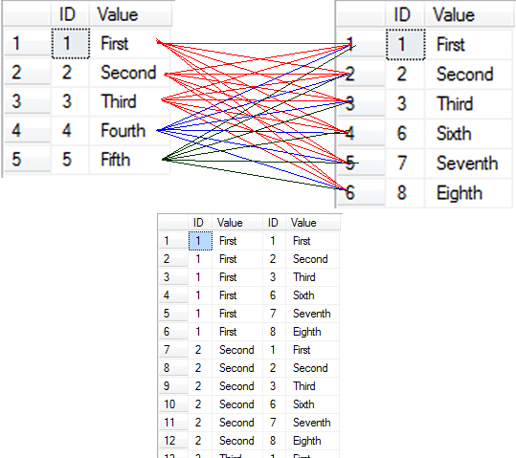
CROSS JOIN
Returns a record set for each combination of records from both tables.
Also known as a Cartesian JOIN

Slide 16
Closer look at CROS JOIN visualization
CROSS JOIN:
a closer look
Image from: https://blog.sqlauthority.com/2009/04/13/sql-server-introduction-to-joins-basic-of-joins/

Slide 17
Other parts of the SELECT statement
SELECT <column list>
FROM <table(s)>
WHERE <where condition>
GROUP BY <column list>
HAVING <where condition>
ORDER BY <column list>
The level to roll up the aggregations
WHERE conditions for aggregates
Sort order for the result set

Slide 18

SELECT Demos
Notes:
Ask for additional questions before moving on

Slide 19
INSERT Statement
assumes all values are known
directs the output of the SELECT
INSERT INTO <table>
(<column list>)
VALUES (<values>)
INSERT INTO <table>
(<column list>)
SELECT <column list>
FROM <table(s)>
WHERE <where condition>
Notes:
Start by looking at what’s similar between the two statements

Slide 20
UPDATE Statement
can be used by alL SQL Databases
T-SQL Specific
UPDATE <table>
SET <column> = '<value>'
WHERE <where condition>
UPDATE <table or alias>
SET <column> = '<value>'
FROM <table(s)>
WHERE <where condition>
Notes:
Start by looking at what’s similar between the two statements

Slide 21
DELETE Statement
can be used by alL SQL Databases
T-SQL Specific
DELETE
FROM <table>
WHERE <where condition>
DELETE <table or alias>
FROM <table(s)>
WHERE <where condition>
Notes:
Start with the FROM clause – notice the similarities and difference.
Note – no column list

Slide 22
INSERT/ UPDATE/ DELETE Demos
Notes:
Ask for additional questions before moving on

Slide 23

Practice, Practice, Practice
Set up a local test database.
Start simple and work up to complex.
Look up examples and use those to learn.
Read some books.
SQL in a Nutshell by Kevin Kline, Daniel Kline and Brand Hunt
T-SQL Fundamentals by Itzik Ben-Gan
Go to your local user group and PASS Virtual User Group meetings.
Keep going to Virtual Conferences, SQL Saturdays, and other events like these.
Notes:
Link for SQL in a Nutshell: https://www.amazon.com/SQL-Nutshell-Desktop-Reference-OReilly/dp/0596518846
T-SQL Fundamentals: https://www.amazon.com/T-SQL-Fundamentals-3rd-Itzik-Ben-Gan/dp/150930200X/ref=sr_1_1?ie=UTF8&qid=1497716204&sr=8-1&keywords=t-sql+fundamentals+book+by+itzik+ben-gan
PASS Virtual Groups: http://www.pass.org/Community/Groups/VirtualGroups.aspx

Slide 24



Have More Questions? Let me know!
Email: dgmelkin@gmail.com
Twitter: @dgmelkin
Blog: DebtheDBA.wordpress.com

Slide 25
Thanks for coming!
Thanks for coming!

